Slide 1
Couchbase Metrics
Daniel Bashary

Slide 2
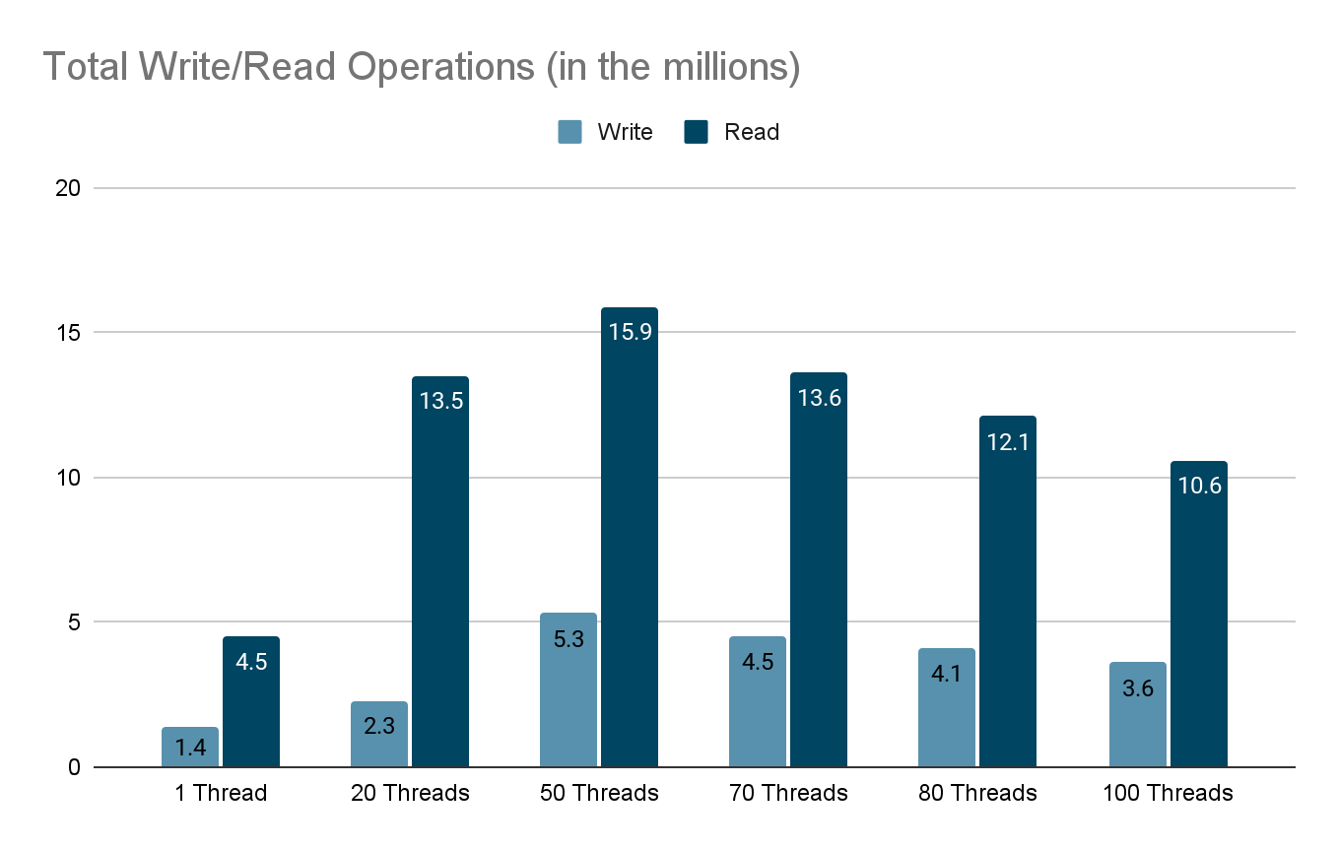

Slide 3
Total Write and Read Operations
Total operations increase with thread count up to 50 threads.
Peak total operations observed at 50 threads.
Beyond 50 threads, total operations begin to decline.
Indicates a point of diminishing returns due to resource contention.

Slide 4
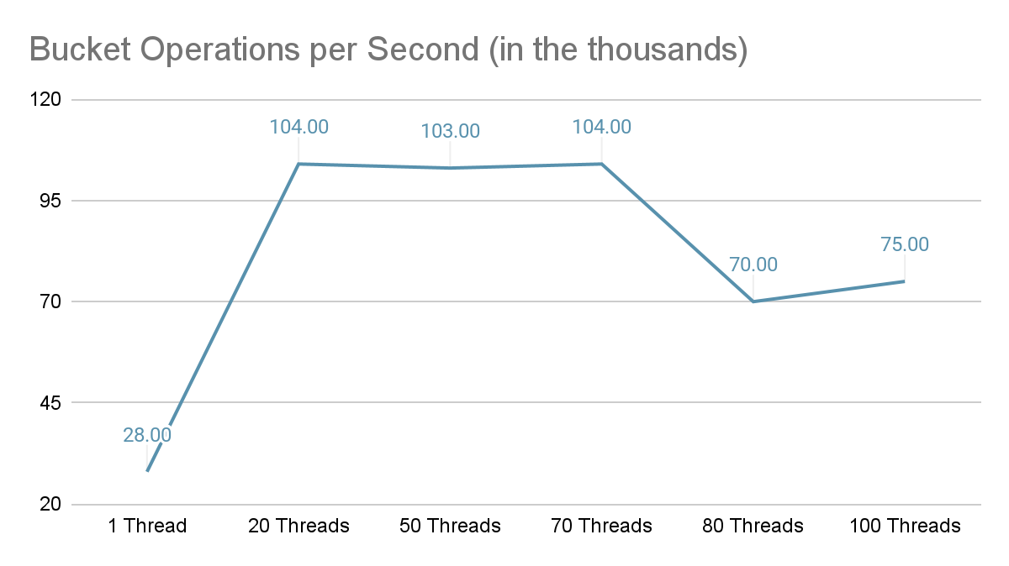

Slide 5
Operations per Second
Throughput peaks at 70 threads with 104,861.9 ops/sec.
Significant drop in throughput at 80 threads.
Slight recovery at 100 threads but does not reach peak levels.
Suggests optimal throughput is achieved between 50 and 70 threads.

Slide 6
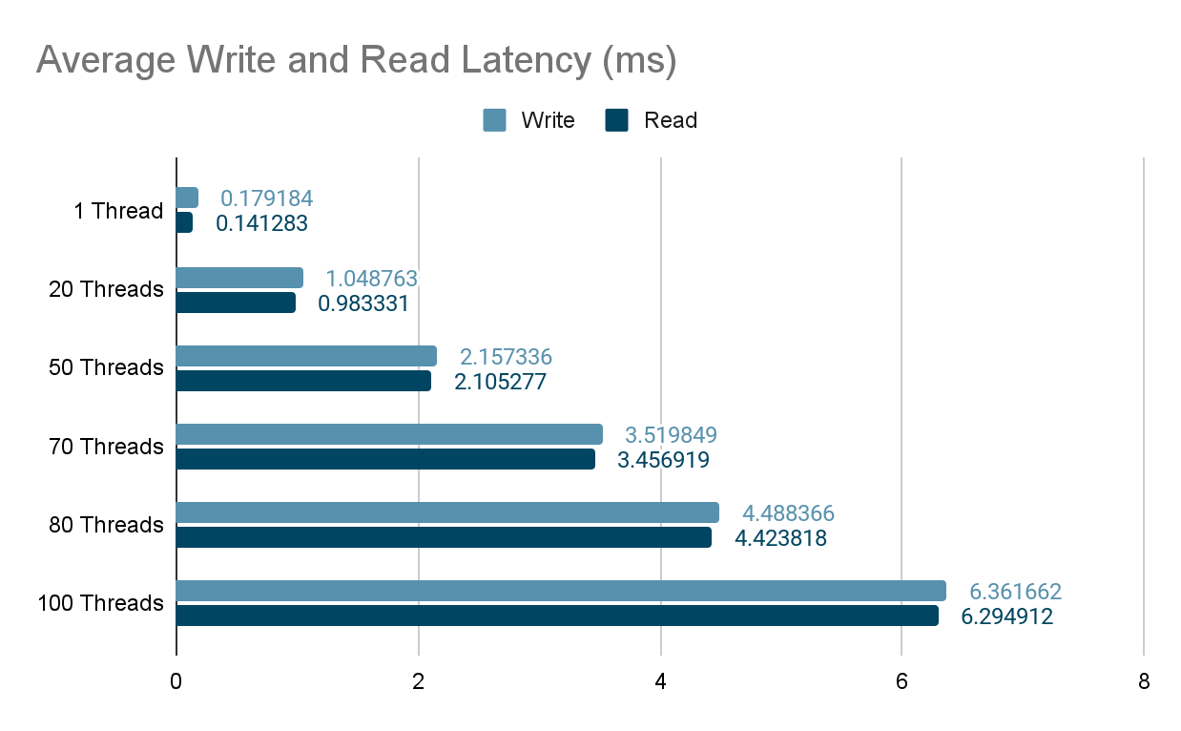

Slide 7
Average Write and Read Latency
Latency increases with the number of threads.
Significant latency spike beyond 50 threads.
High latency at 80 and 100 threads correlates with decreased throughput.
Indicates that the system is becoming overloaded.

Slide 8
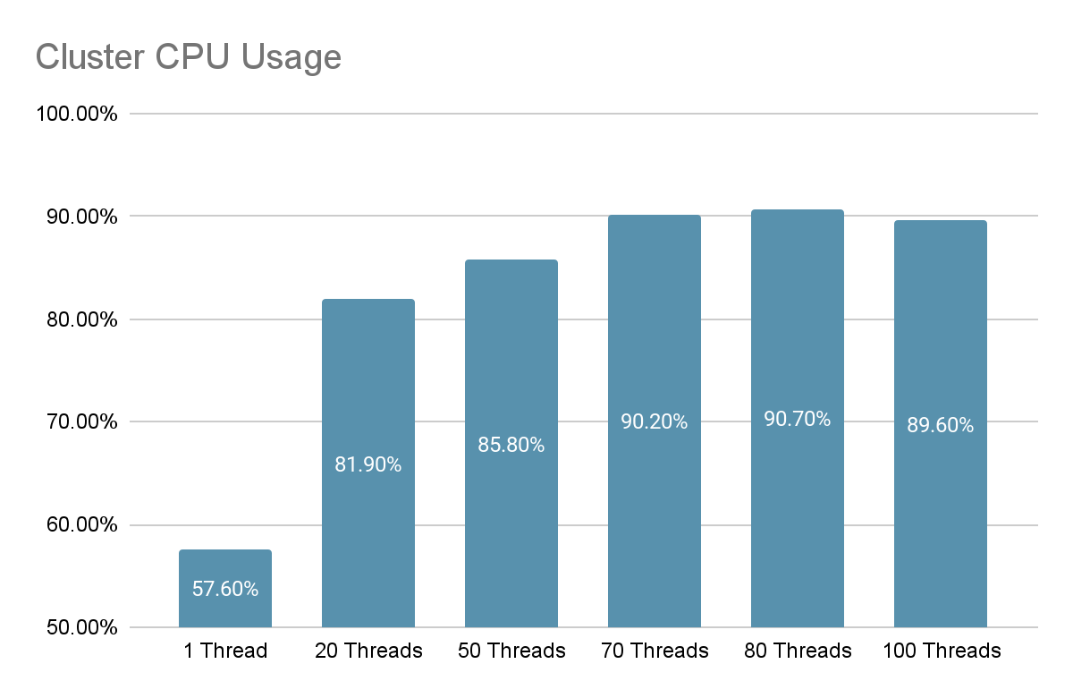

Slide 9
Cluster CPU Usage
CPU usage increases with thread count.
Near CPU saturation at 80 threads (over 90% usage).
High CPU usage contributes to increased latency.

Slide 10
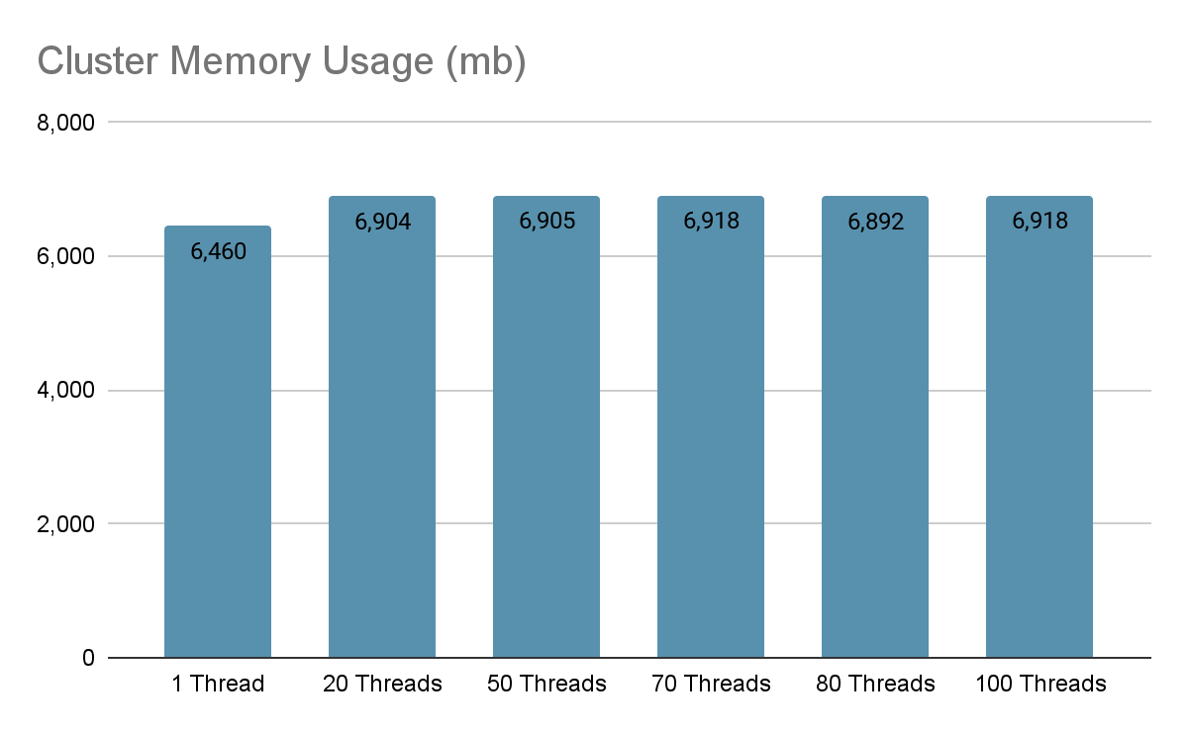

Slide 11
Cluster Memory Usage
Memory usage remains relatively stable across different thread counts.
No significant memory bottlenecks observed.
Suggests that CPU is the primary limiting resource.

Slide 12
Conclusions
Use a thread count of 50 for optimal performance in this environment.
Maintain thread count below 70 to prevent excessive latency.
Horizontally scale by adding more nodes to accommodate higher concurrency needs.
Upgrade CPU resources if further concurrency beyond the current limits is required.

